Slide 1



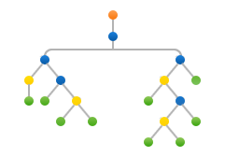
Machine Learning
Decision Tree
(Python Implementation)

Slide 2
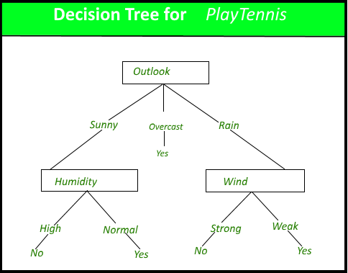
Decision Tree
Decision tree is the most powerful and popular tool for classification and prediction.
A Decision tree is a flowchart like tree structure, where each internal node denotes a test on an attribute, each branch represents an outcome of the test, and each leaf node (terminal node) holds a class label.

Slide 3
Decision Tree (Construction)
A tree can be “learned” by splitting the source set into subsets based on an attribute value test.
This process is repeated on each derived subset in a recursive manner called recursive partitioning.
The construction of decision tree classifier does not require any domain knowledge or parameter setting, and therefore is appropriate for exploratory knowledge discovery.
Decision trees can handle high dimensional data, and in general a decision tree classifier has good accuracy.
Decision tree induction is a typical inductive approach to learn knowledge on classification.

Slide 4
Decision Tree (Representation)
Decision trees classify instances by sorting them down the tree from the root to some leaf node, which provides the classification of the instance.
An instance is classified by starting at the root node of the tree, testing the attribute specified by this node, then moving down the tree branch corresponding to the value of the attribute.
This process is then repeated for the subtree rooted at the new node.
The decision tree in the given figure classifies a particular morning according to whether it is suitable for playing tennis and returning the classification associated with the particular leaf.(in this case Yes or No).
In other words we can say that decision tree represent a disjunction of conjunctions of constraints on the attribute values of instances.

